Slide 1
WQD7006: Machine Learning for Data Science Vimala Balakrishnan Semester II, Session 2019/2020
Introduction to Machine Learning

Slide 2
Data Science
Multidisciplinary blend of data inference, algorithm development, and technology in order to solve analytically complex problems.
Multidisciplinary field that uses scientific methods, processes, algorithms and systems to extract knowledge and insights from data in various forms, both structured and unstructured

Slide 3
Data Scientist
“Someone who can obtain, scrub, explore, model and interpret data, blending hacking, statistics and machine learning”
-- Hilary Mason, chief scientist at bit.ly

Slide 4
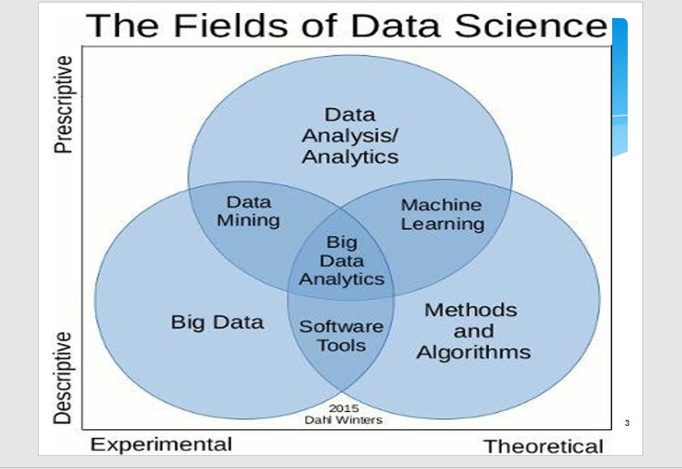
Data Science & Machine Learning?

Slide 5
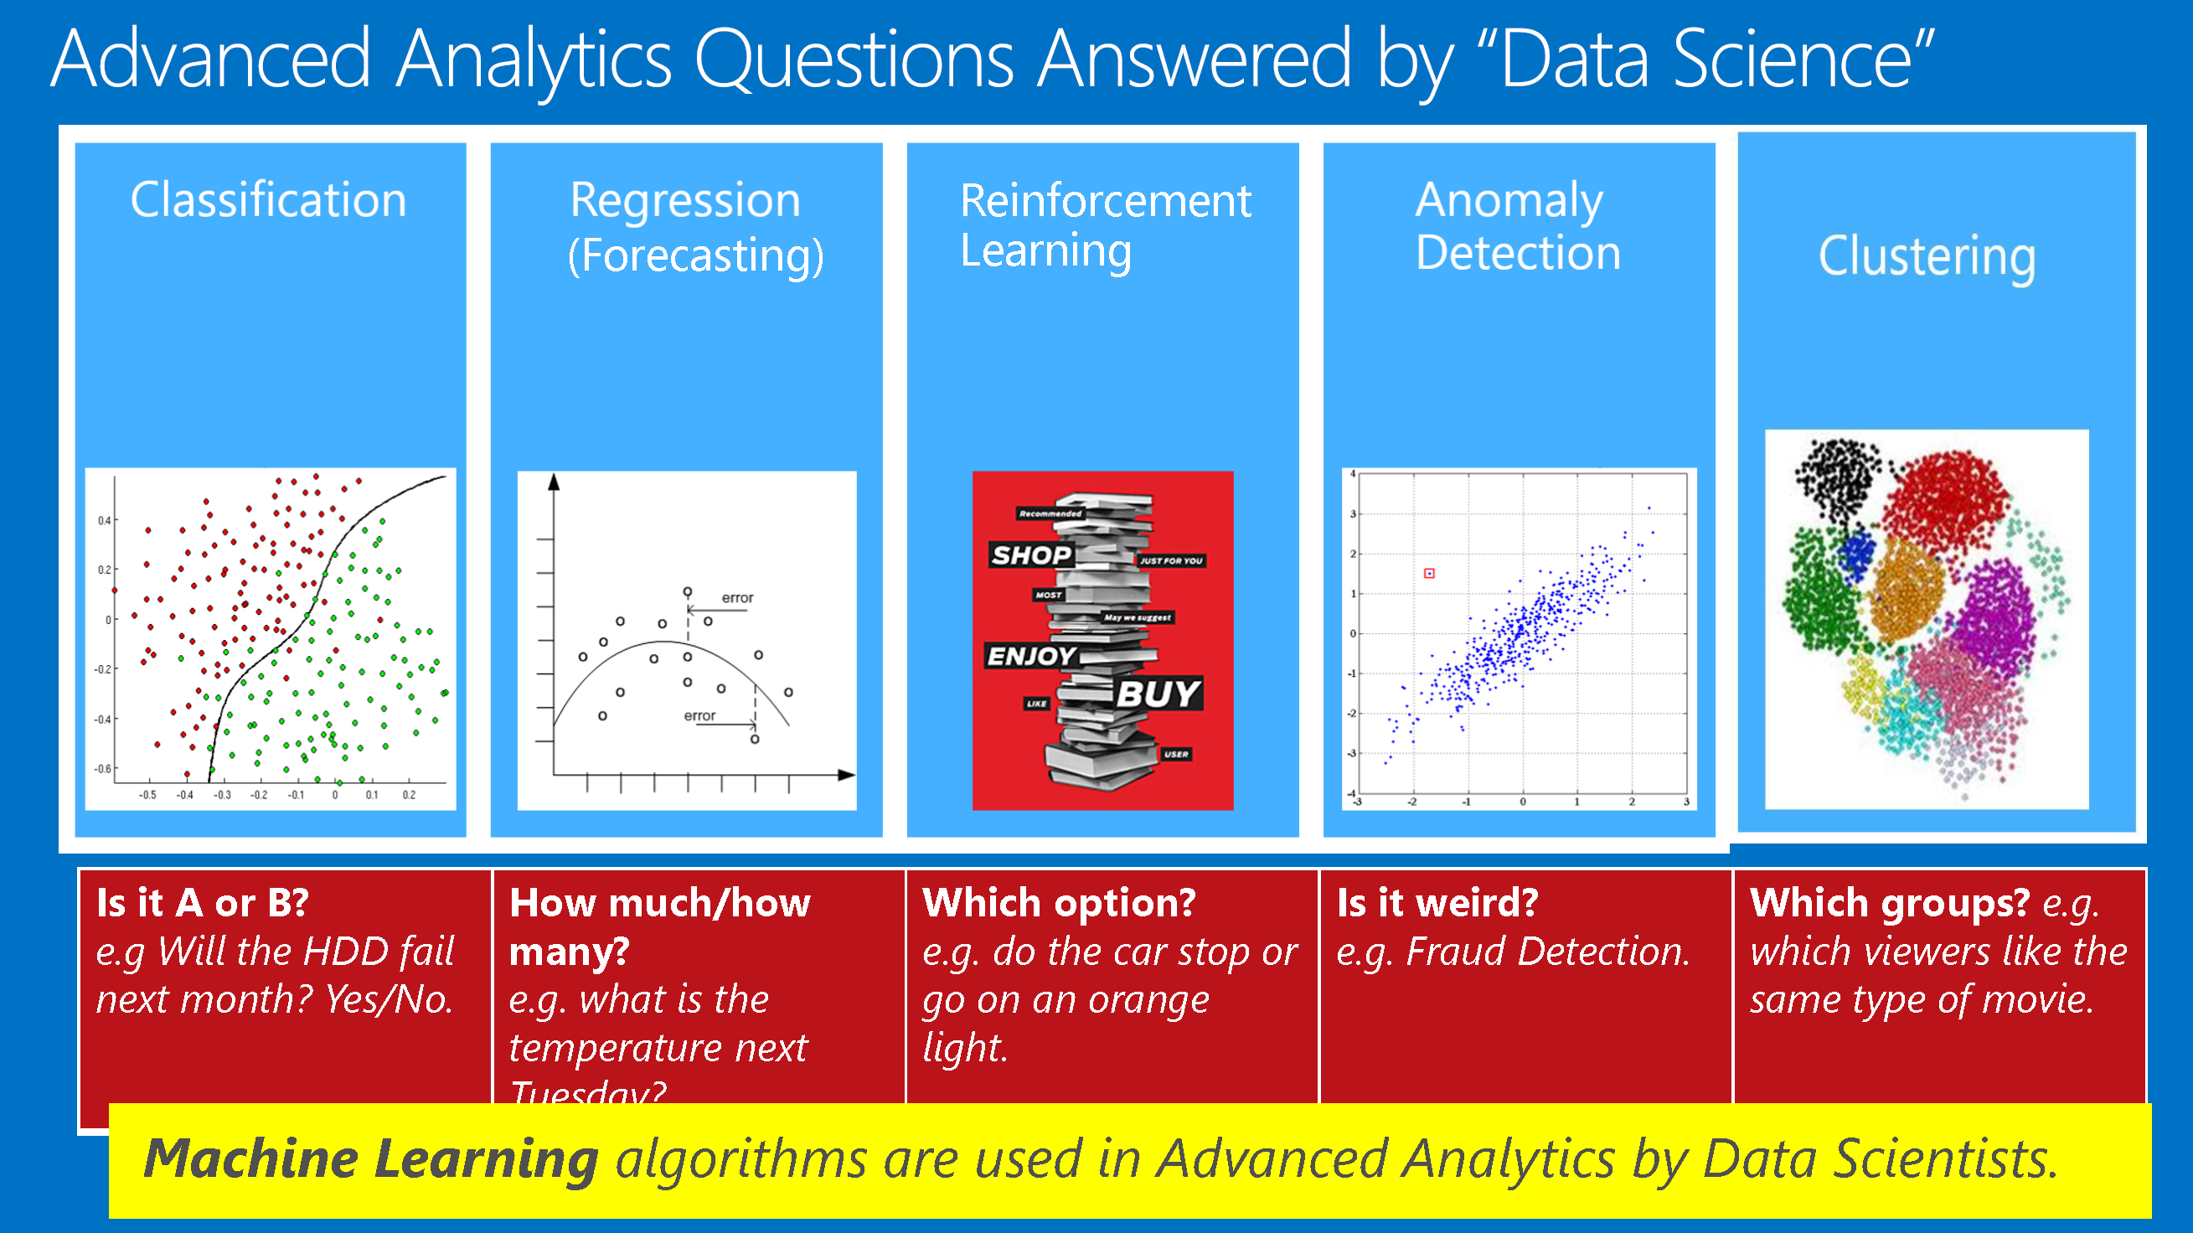
Data Science & Machine Learning?

Slide 6
Data Science & Machine Learning?
Data is cheap and abundant, knowledge is expensive and scarce.

Slide 7
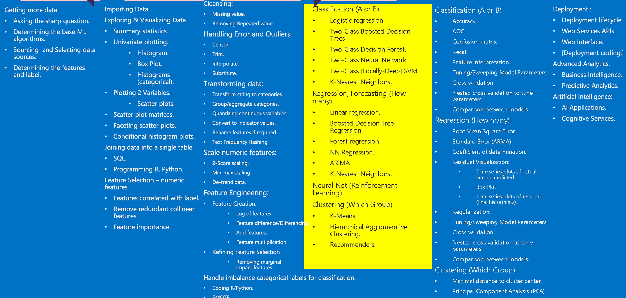
‘Where’ is Machine Learning in Data Science?
MACHINE LEARNING
Business Understanding
Data Understanding
Data Preparation
Modeling
Evaluation
Deployment

Slide 8
2. What is Machine Learning?
Generally and specifically

Slide 9
Machine Learning
Traditional Programming
Machine Learning
Data
Computer
Output
Program
Data
Computer
Program
Output

Slide 10
Applications of Machine Learning
Database mining
Large datasets from growth of automation/web.
E.g., Web click data, medical records, biology, engineering
Applications & automation
E.g., Autonomous helicopter, handwriting recognition, most of Natural Language Processing (NLP)
- Self-customizing programs
E.g., Amazon, Netflix product recommendations
- Understanding human learning (robotics).

Slide 11


Applications of Machine Learning

Slide 12
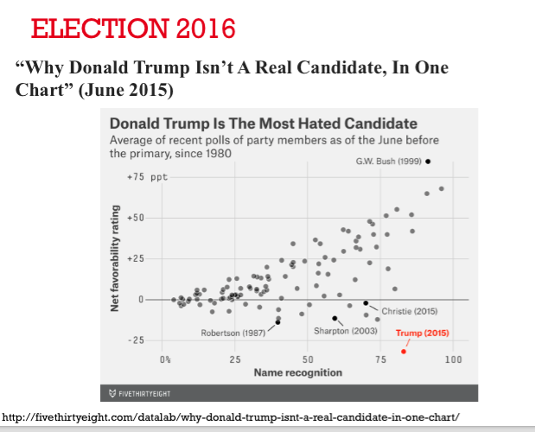

Slide 13
Definition of Machine learning
Arthur Samuel (1959). Machine Learning:
Field of study that gives computers the ability to learn without being explicitly programmed.
Tom Mitchell (1998)
Well-posed Learning Problem:
A computer program is said to learn from experience E with respect to some task T and some performance measure P, if its performance on T, as measured by P, improves with experience E.

Slide 14
#Checkpoint
“A computer program is said to learn from experience E with respect to some task T and some performance measure P, if its performance on T, as measured by P, improves with experience E.”
Suppose your email program watches which emails you do or do not mark as spam, and based on that learns how to better filter spam. What is the task T in this setting?
Classifying emails as spam or not spam.
Watching you label emails as spam or not spam.
The number (or fraction) of emails correctly classified as spam/not spam.
None of the above—this is not a machine learning problem.

Slide 15
Machine learning in a nutshell
Every machine learning algorithm has three components:
Representation – decision trees, rules, neural networks, ensemble methods etc.
Evaluation – precision, recall, AUC, likelihood etc.
Optimization –
Combinatorial optimization
E.g.: Greedy search
Convex optimization
E.g.: Gradient descent
Constrained optimization
E.g.: Linear programming

Slide 16
Types of Learning Algorithms
Machine learning algorithms:
Supervised (inductive) learning (task driven)
Training data with desired outputs
Prediction
Classification (discrete labels), Regression (real values)
Unsupervised learning (data driven)
Training data without desired outputs
Clustering
Probability distribution estimation
Finding association (in features)
Dimension reduction

Slide 17
Types of Learning Algorithms
Machine learning algorithms:
Semi-supervised
Training data with a few desired outputs
Others:
Reinforcement learning (delayed reward), decision making (robot, chess game)
Recommender systems.

Slide 18
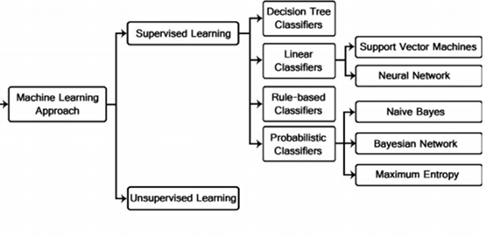
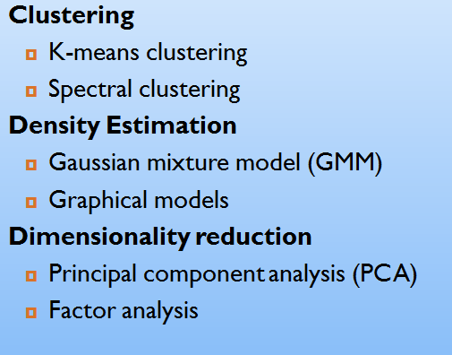
Types of Learning Algorithms
Medhat et al., 2014

Slide 19
3. Introduction to Supervised Learning
Supervised?

Slide 20
Supervised Learning and Regression
Given examples of a function (X, F(X))
Predict function F(X) for new examples X
Discrete F(X): Classification
Continuous F(X): Regression
F(X) = Probability(X): Probability estimation

Slide 21
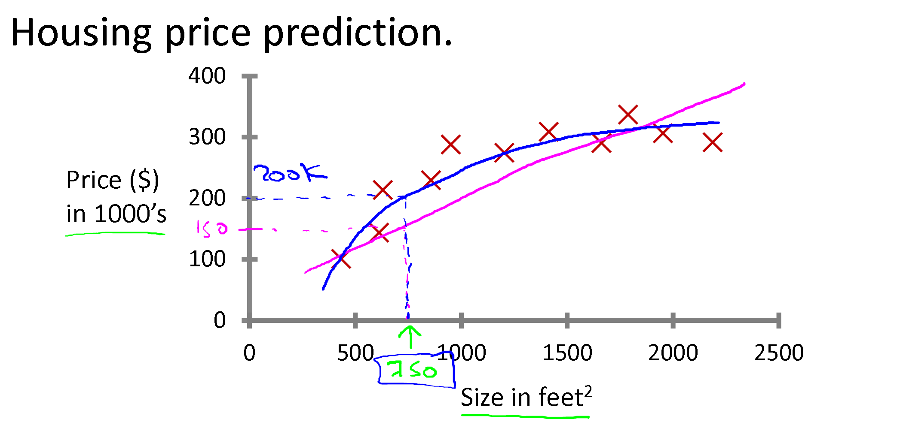
Supervised Learning and Regression
Regression: Predict continuous valued output (price)

Slide 22
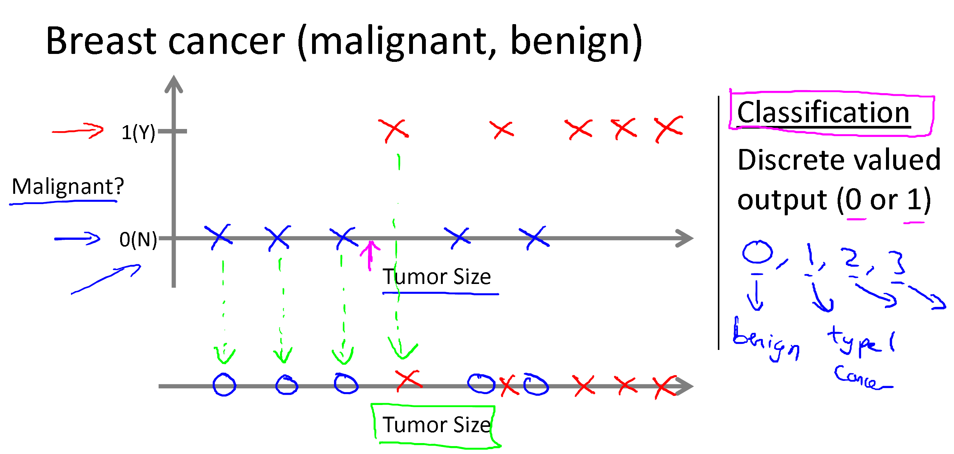
Supervised Learning for Classification

Slide 23
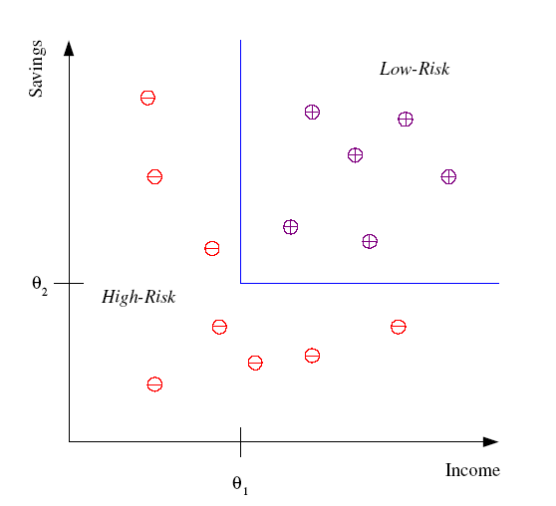
Supervised Learning for Classification
Example: Credit scoring
Differentiating between low-risk and high-risk customers from their income and savings
Discriminant: IF income > θ₁ AND savings > θ₂
THEN low-risk ELSE high-risk
Model

Slide 24
#Checkpoint
You’re running a company, and you want to develop learning algorithms to address each of two problems.
Problem 1: You have a large inventory of identical items. You want to predict how many of these items will sell over the next 3 months.
Problem 2: You’d like software to examine individual customer accounts, and for each account decide if it has been hacked/compromised.
Should you treat these as classification or as regression problems?

Slide 25
4. Introduction to Unsupervised Learning
Unsupervised?

Slide 26
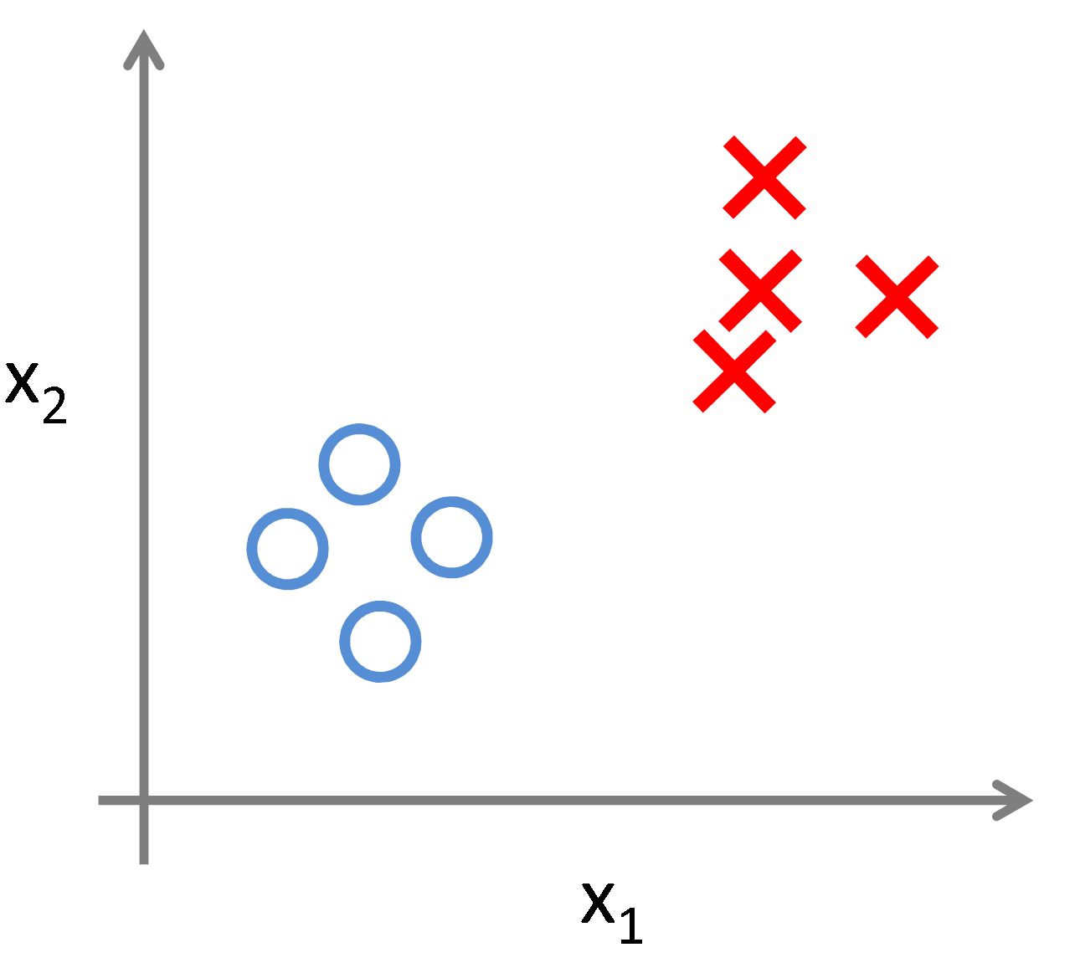
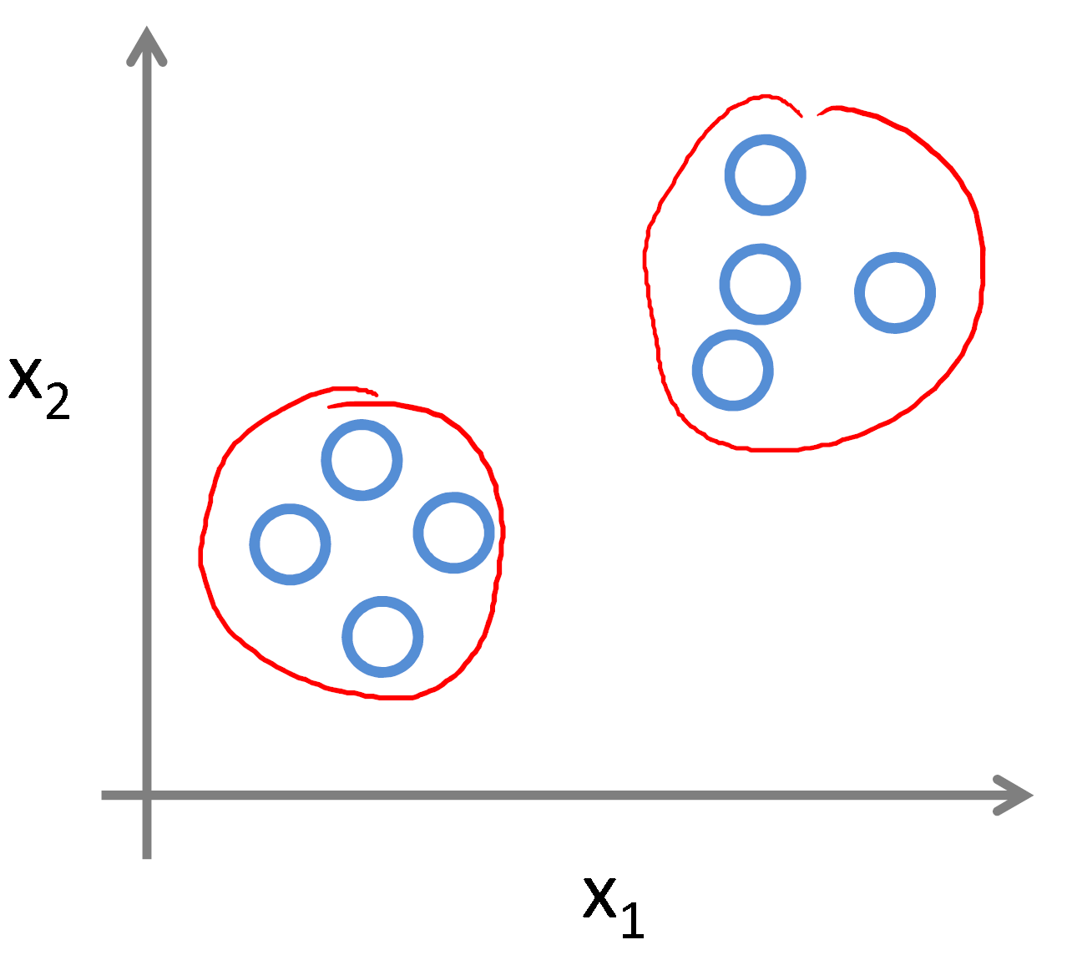
Supervised Learning vs Unsupervised Learning
Supervised Learning
Unsupervised Learning

Slide 27
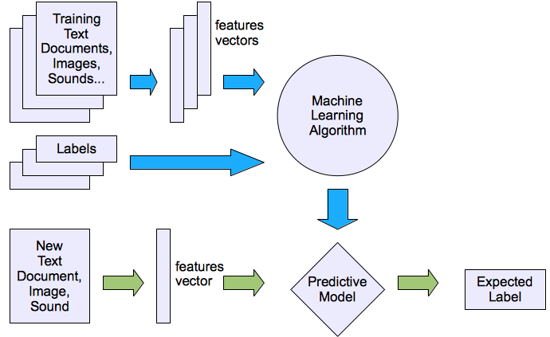
Supervised Learning
We seek low E-out or maximize probabilistic terms

Slide 28
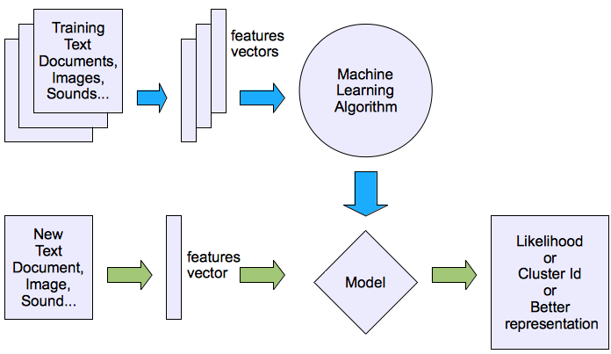
Unsupervised Learning
We seek minimum distance, MLE(maximum likelihood estimation) etc.

Slide 29
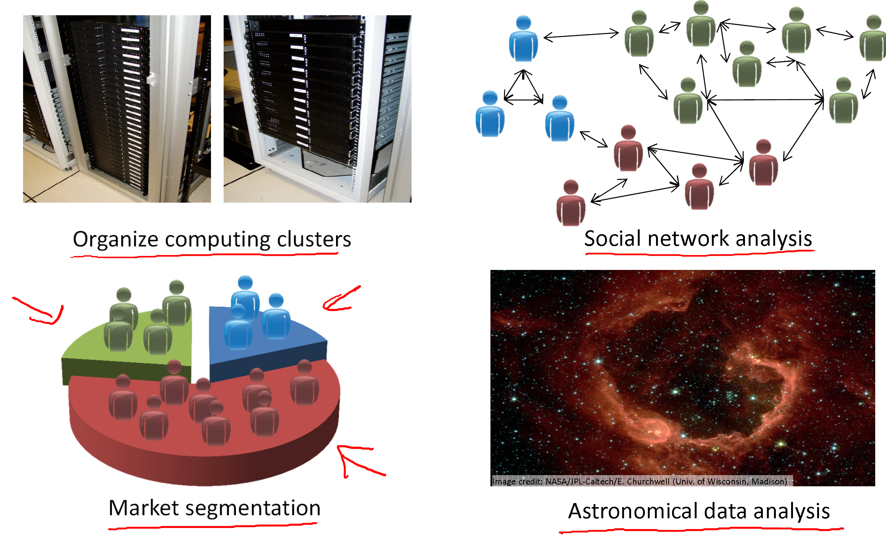
Sample Applications for Unsupervised Learning

Slide 30
#Checkpoint
Of the following examples, which would you address using an unsupervised learning algorithm?
Given a database of customer data, automatically discover market segments and group customers into different market segments.
Given email labeled as spam/not spam, learn a spam filter.
Given a set of news articles found on the web, group them into set of articles about the same story.
Given a dataset of patients diagnosed as either having diabetes or not, learn to classify new patients as having diabetes or not.

Slide 31
Bummer!!! Data Science Evolution (10%)
Submission and Presentation – March 16, 2020

